Slide 1
Discovering Triangles
A journey through art, geometry and real life

Slide 2
Triangles Properties
Is it always possible to construct a triangle? Math Class: Triangle Inequality Theorem

Slide 3
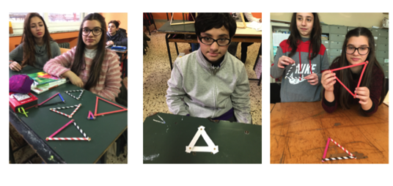
Triangles Properties
Is it always possible to construct a triangle? Math Class: Triangle Inequality Theorem

Slide 4
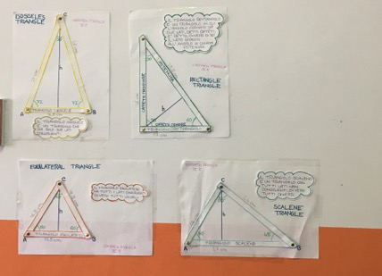
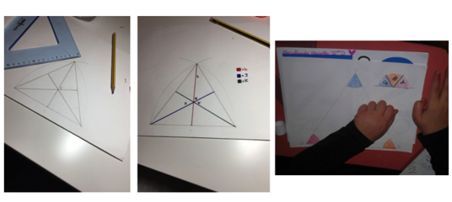
Triangles Properties

Slide 5
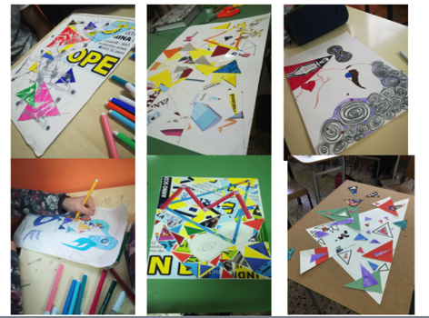
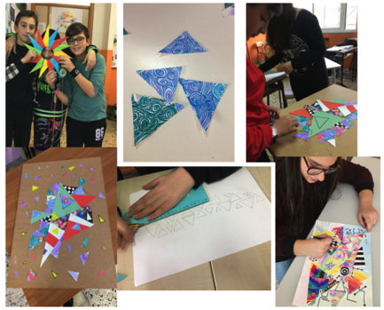
Art Class

Slide 6
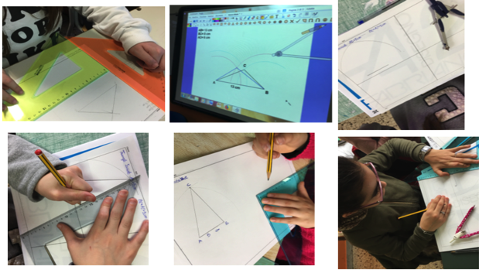
The geometric triangle construction

Slide 7
The geometric triangle construction

Slide 8
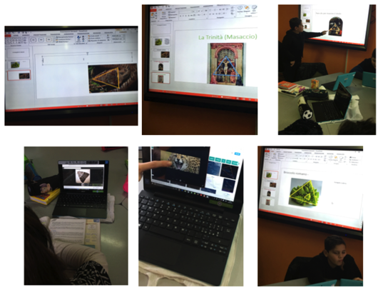
Triangles in real life: Art, Nature and Architecture

Slide 9
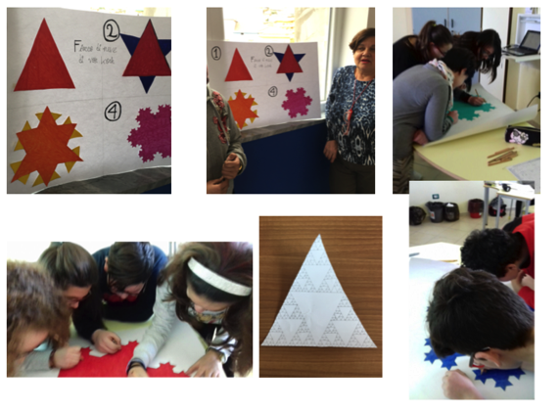
Fractals: Sierpinski Triangle and Koch snowflacke

