Slide 1
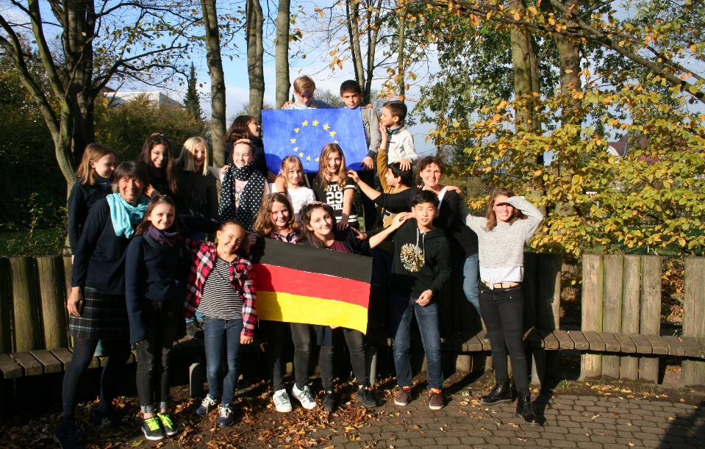
Preliminary Activities at Wilhelmsgymnasium Kassel:
Organization: Introduction of an extracurricular course „Erasmus“: 18 students, 5 from 5th year (10-11 years), 13 from 6th year (12 years old), 5 boys, 13 girls, two teachers: Frau Porsche, Frau Küch, every Thursday afternoon, 60 minutes
b) What has been done so far?
1. Photography and Storytelling
Challenge 2. Introduction to eTwinning in general and our Twinspace 3. Culture and Arts Quiz 4. First Module on Mathematics and Art (in progress)

Slide 2
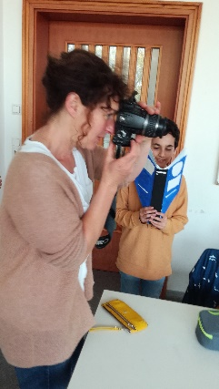
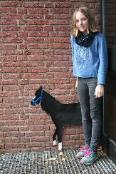
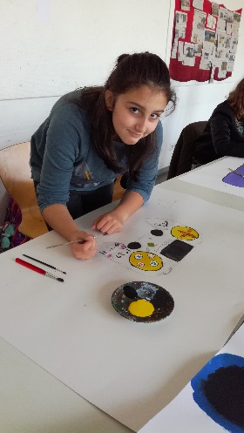
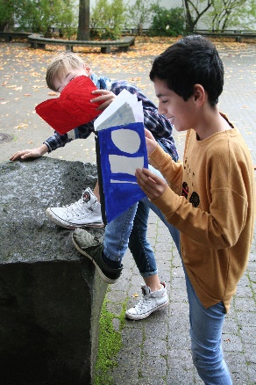
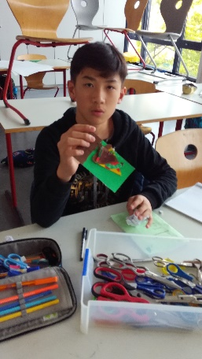
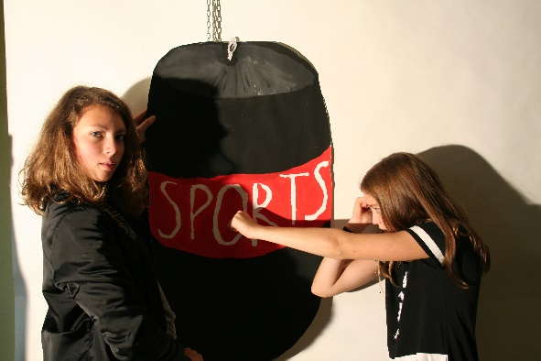
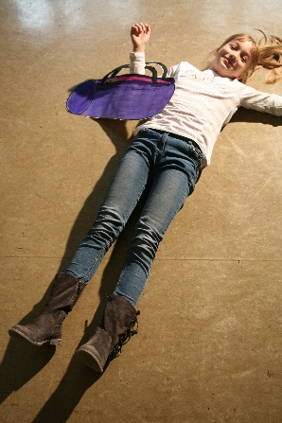
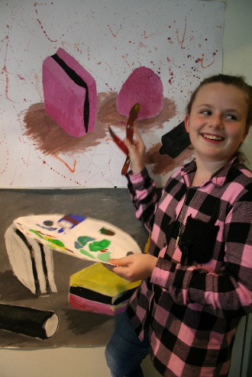
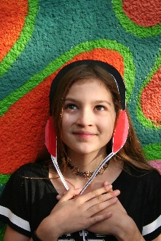
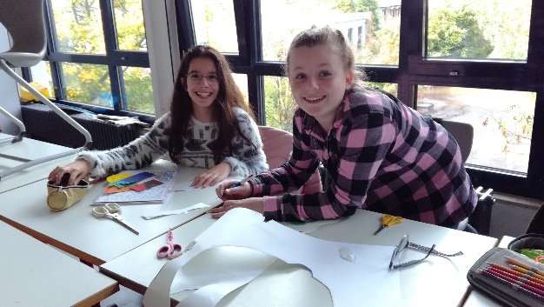
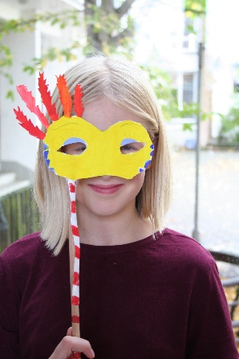
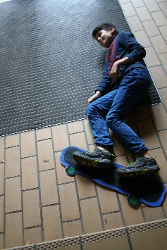
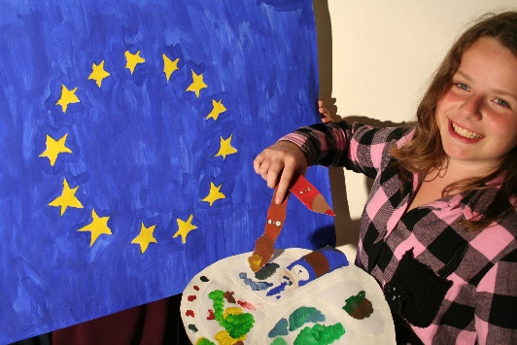
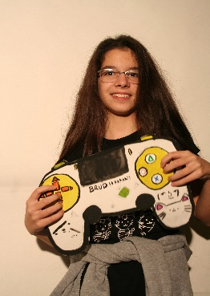
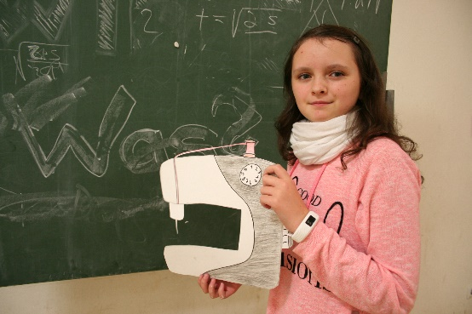
1. Photography and Storytelling Challenge

Slide 3
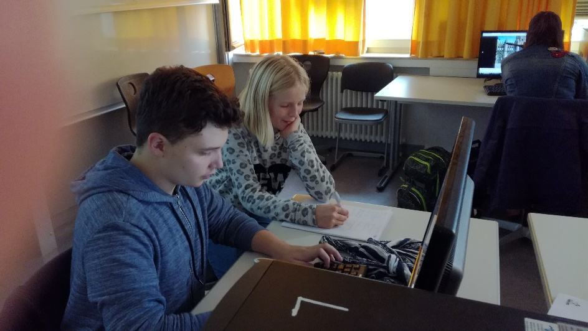
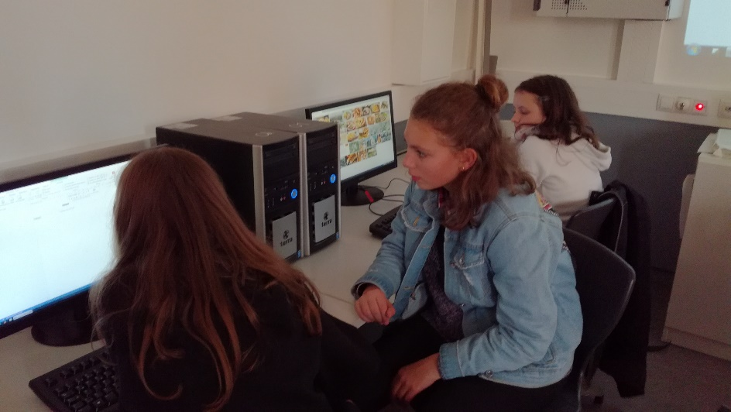
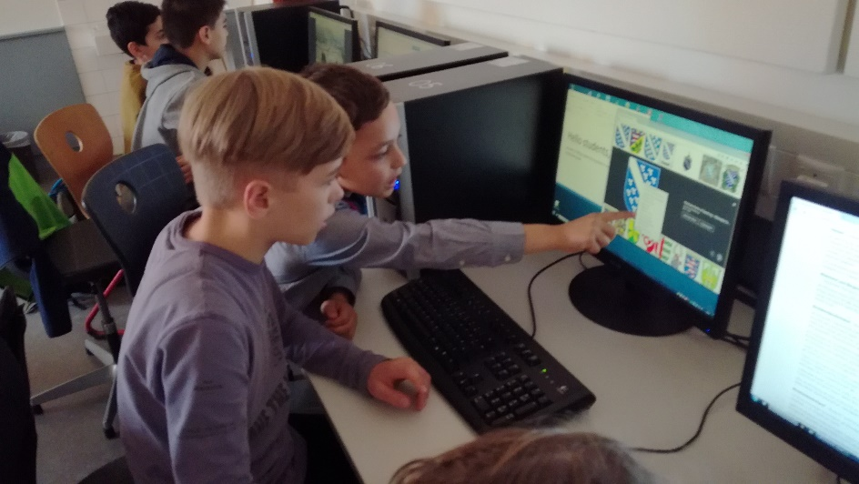
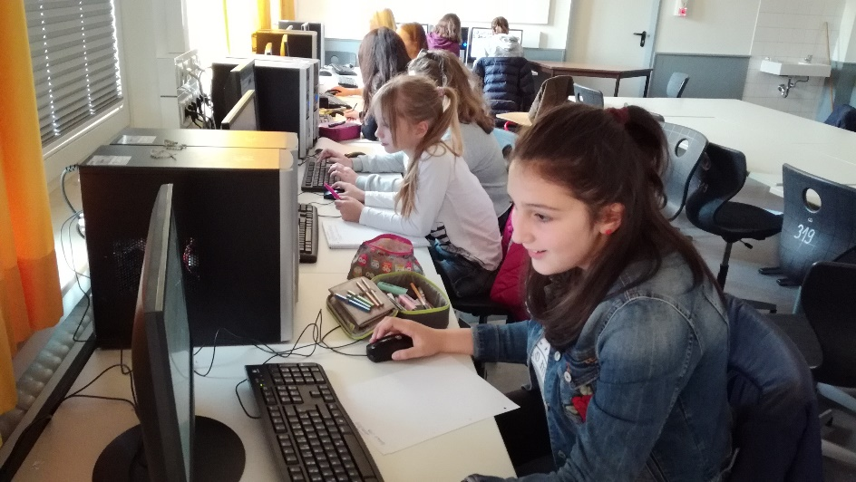
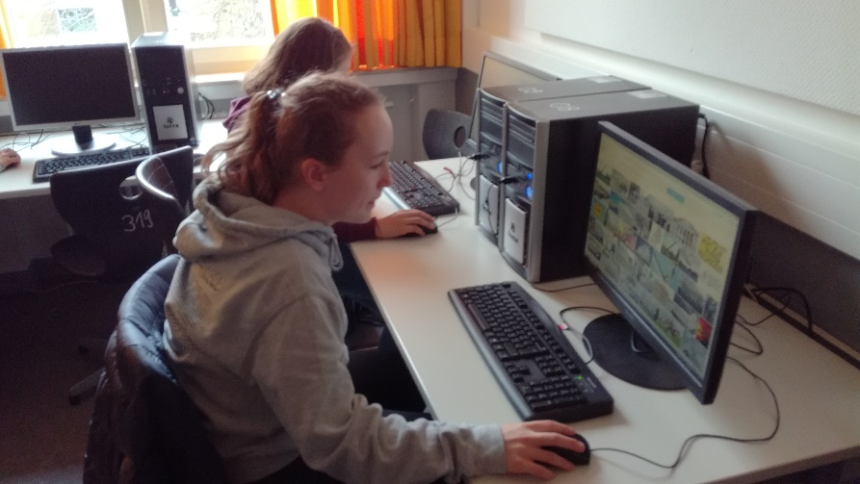
2. Introduction to eTwinning and Twinspace (technical support: Fabio, a highschool
student who is experienced in IT and wants to become a teacher)

Slide 4
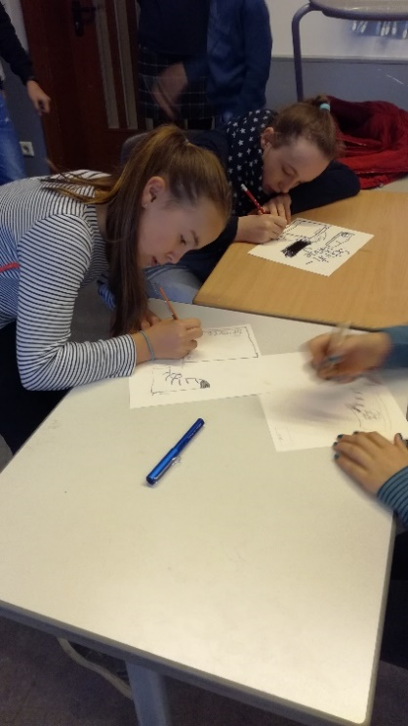
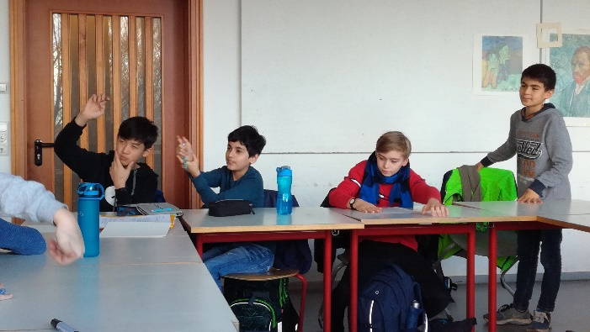
3. Culture and Arts Quiz
Discussion on clichés: What do we think/expect of other cultures, what might they think about us?
Where can this be helpful or dangerous?
Which topics might be suitable to present the culture of our country/city/school?
Students collect information and work in groups on different subjects/quizzes.

Slide 5
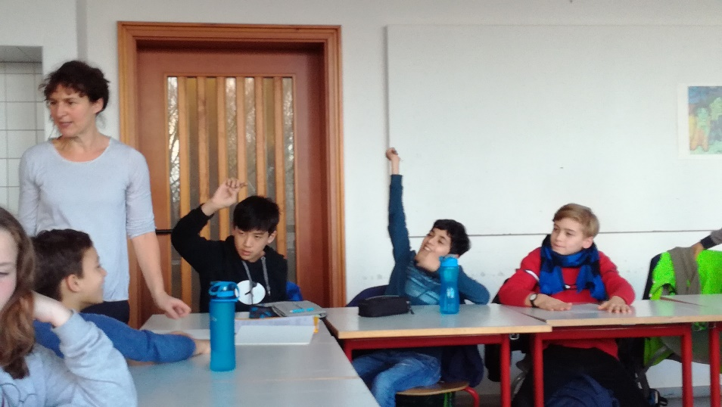
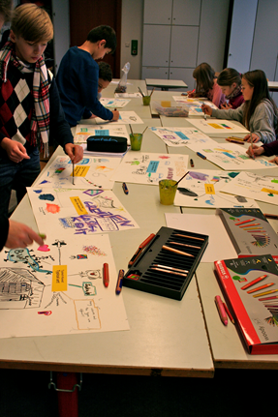
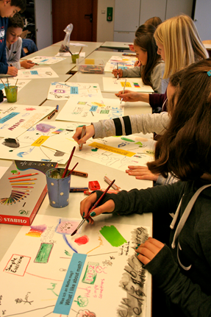
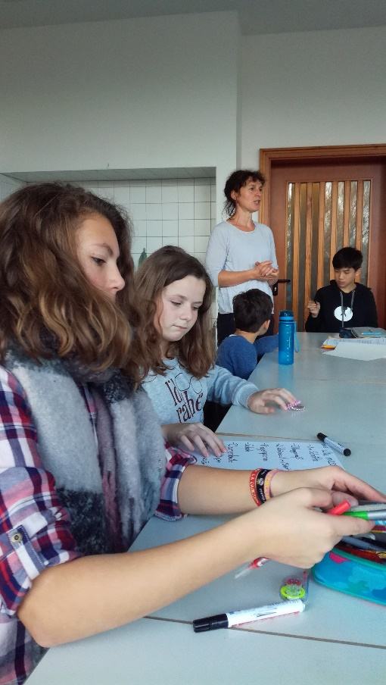
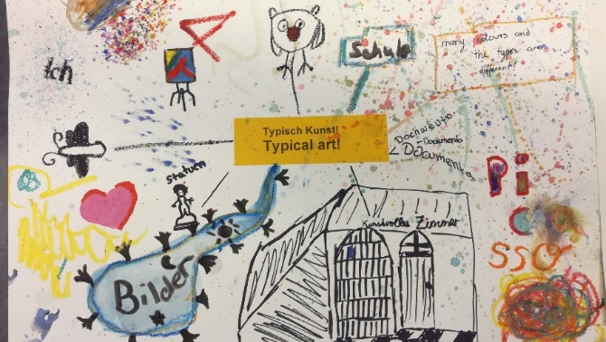
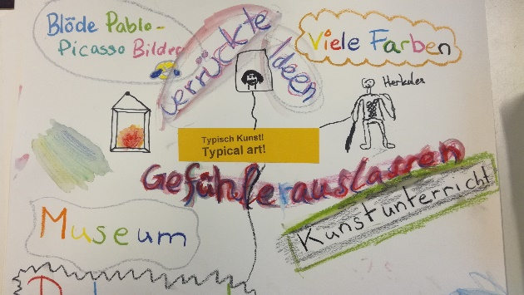
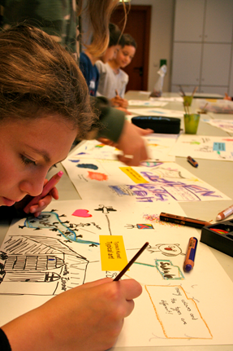
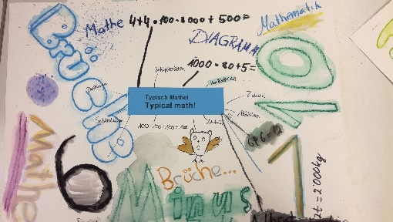
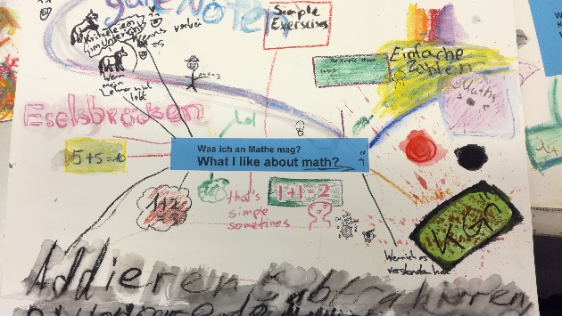
4. First Module on Maths and Arts
Mind Maps:
What I like about Art
What I like about Maths
What happens when Art and Maths meet?
Where does Maths meet me in everyday
What I find difficult about Maths
.

Slide 6
Typical Art
„pictures, paintings, statues, documenta, colours, drawing, painting, sketching, museum, comic, Picasso, imagination, letting out feelings, sometimes doesn‘t make sense, is beautiful, Krickel Krackel (scribbling), portrait, Leonardo da Vinci, Kandinsky, van Gogh“ etc.
What did the students say?
Typical Maths: “1+1, numbers, calculate, puzzle, speculate, fractions, pieces of cake and pizza as examples of fractions, think and remember lots, geometry, addition, subtraction, division, multiplication, contests, formulas, difficult, bad marks, broken compass, right angle, Albert Einstein“ etc.
What I find difficult in Maths
„abstract symbols, adding and subtracting fractions, decimal numbers, measurements, cm, mm, sorting fractions, KGV und GGT, changing fractions into decimal numbers“ etc.

Slide 7
Starting point: modern times/ mass media/ children are losing contact with their bodies and surroundings/ insufficient experience with physical movement and expression/spatial orientation/proportions/orientation
Working title: „My body – Mathematics and Arts: understanding, grasping and experiencing Maths and art with or through our bodies “
Albert Einstein: „Learning is experience. Everything else is just information.“
Ideas for several Maths modules:
estimating lenths, measuring, developing a relation of oneself to architecture and man-made environment, dimensions, playing with proportions, Vitruv, Leonardo da Vinci, Albrecht Dürer
sorting, comparing, making lines of different body sizes, patterns, visualizing diagrams and statistics, understanding scale, order and chaos, „tidying up art“
reflections of the body
Stepping through a piece of paper
Games of movement: forming numbers with your body, forming polygons from bodies/hands
incoporating music/rhythm
Meeting with Maths teachers to find out about possible uses in 5th (and 6th class) Mathematics

Slide 8
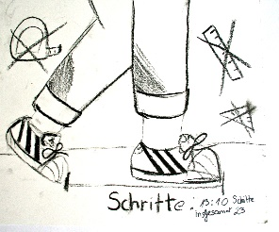
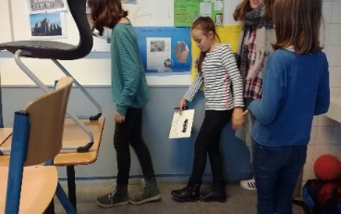
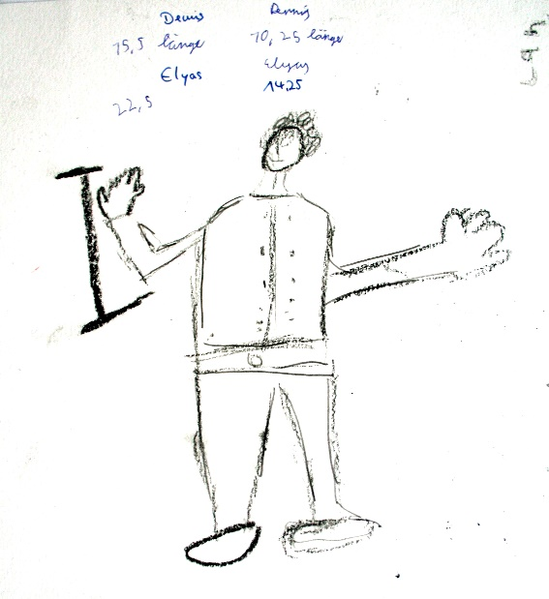
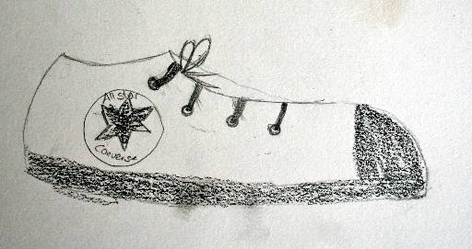
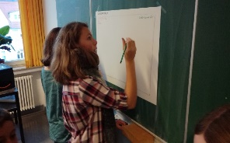
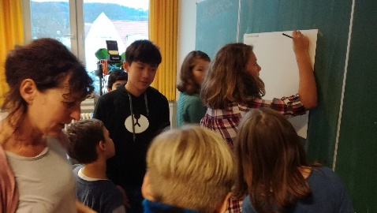
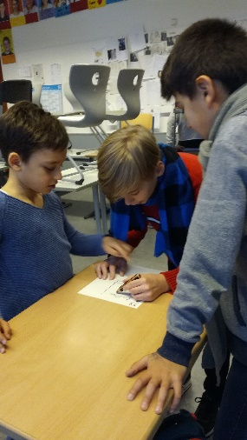
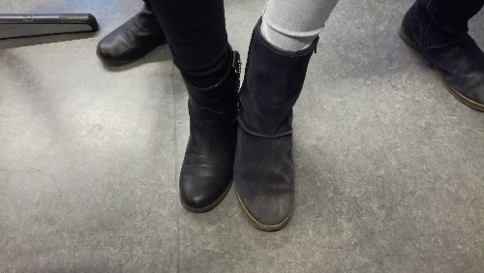
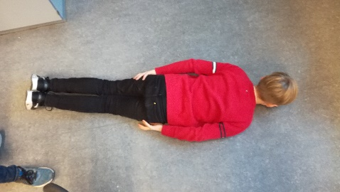
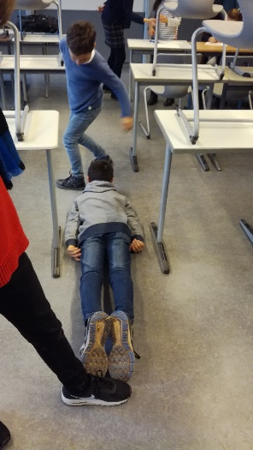
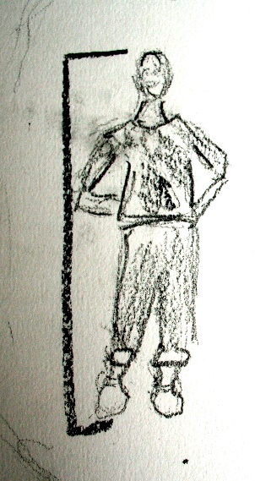
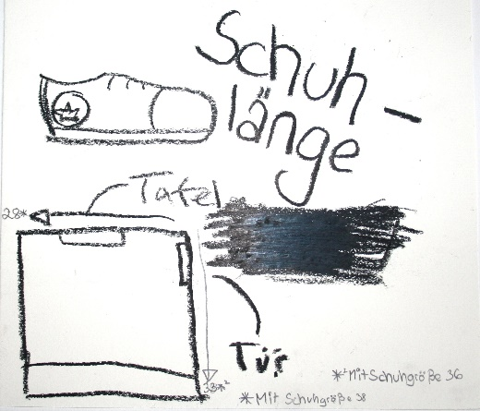
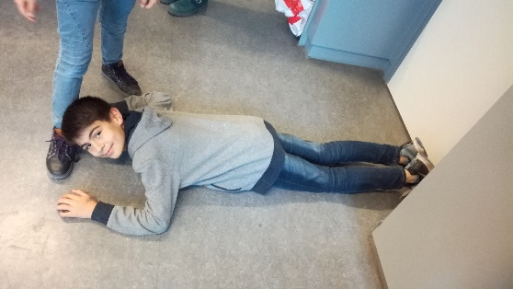
Mind storming: How can you measure when you don‘t have measurements? Discovery studio: Using your body for measuring a classroom.

Slide 9
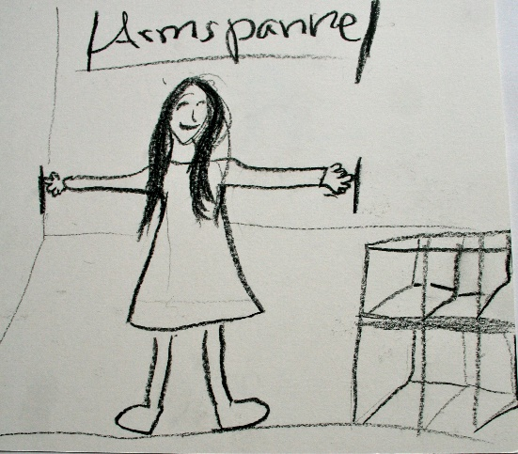
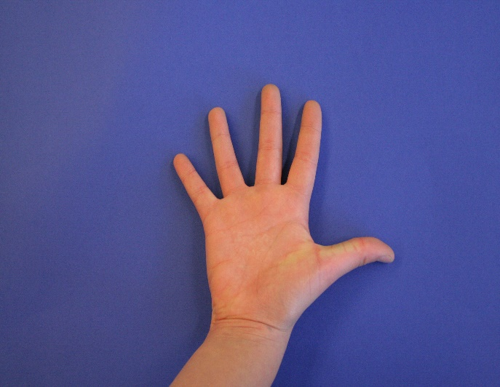
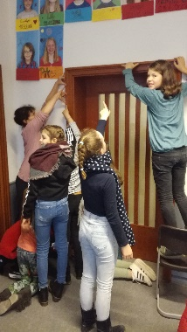
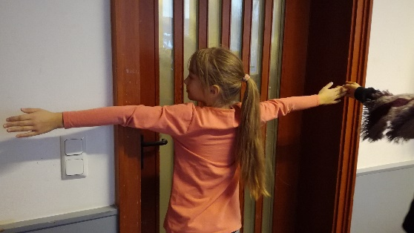
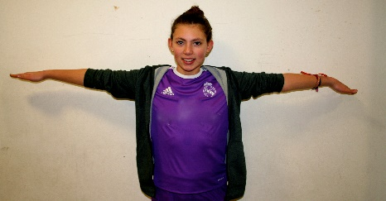
Making body measurement cards

Slide 10
Exploring different dimensions: How can we find the average body size of the whole group ?
Collecting ideas and proving them
Idea 1: Getting into line according to our body sizes
Elli is our average girl!

Slide 11
Idea 2: Visualizing our body size by drawing body silhouettes

Slide 12
Idea 3: Establishing a relation between body parts and elements from the metric system (cm,m,mm): measuring our body parts and calculating our average size: 1,54 cm

Slide 13
Exploring proportions: What happens if the human being is NOT the measure of all things?

Slide 14
Outlook:
Working with different scales.
Estimating, Fermat: How many students fit into a soccer pitch, how high is the canteen? How many people do you need to surround our school building?
Playing a memory game with measurements.
Visualizing different diagrams.
(with the support of a Maths teacher)
________________________
Learning opportunities of this module:
getting a better understanding of your body – being conscious of it in three-dimensional space
social interaction: working in groups and with partners
appreciating aesthetic and cognitive results
calculating averages
discovering your own body as a tool for different measurements
learning with all your senses
recognizing the necessity of standardized measuring
from estimation to measurement

